Slide 1
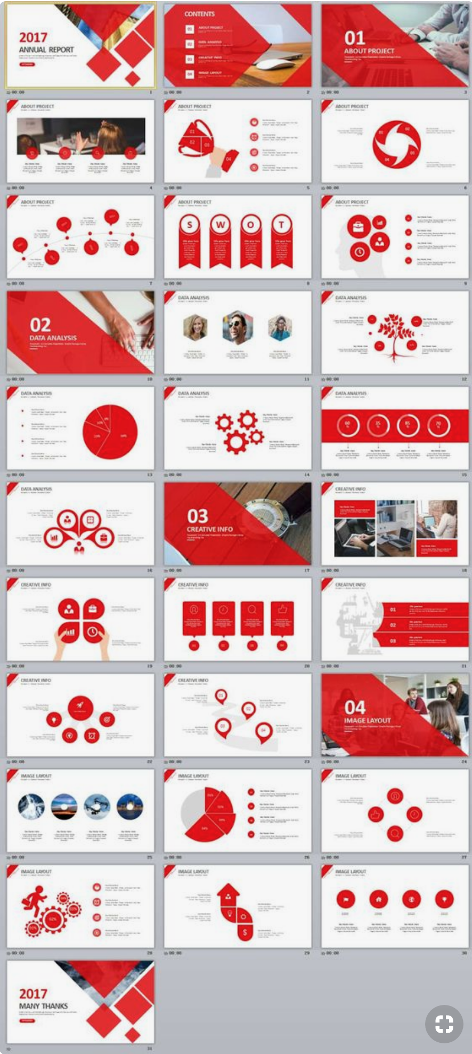
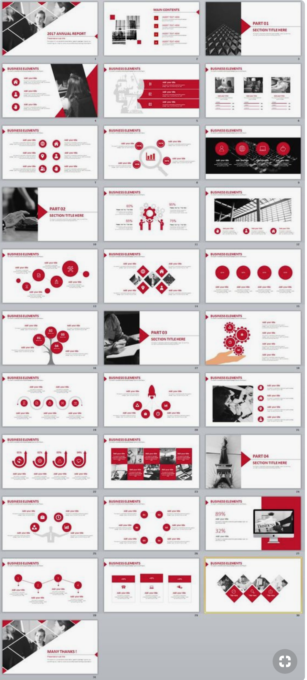
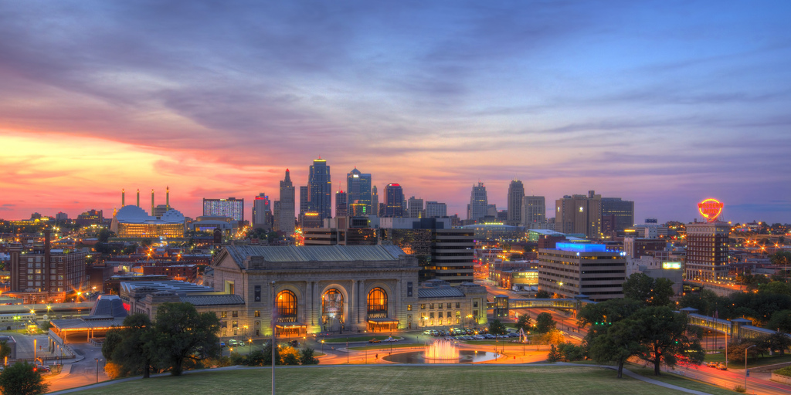
VISIT KC
An Interactive Guide to Kansas City

Slide 2
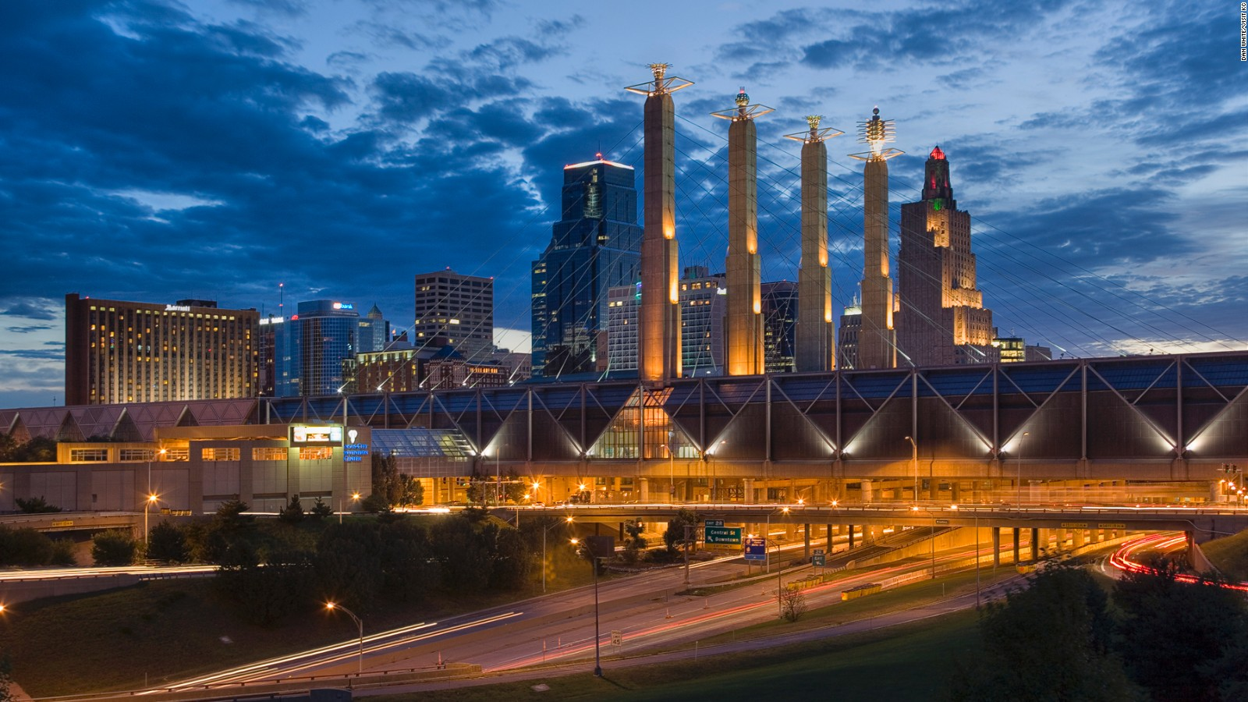
THE PREMISE

Slide 3
THE PROCESS
Our goal was to provide information about Kansas City in one convenient place
Initially our scope was big.
We created a Web Scrape for some basic KC information as well as links to attractions and leaflet maps.
We used city-data.com and twitter for the web scraping and leaflet for mapping

Slide 4


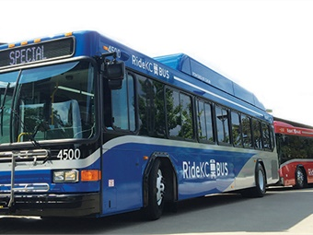
Title
Creating the app.py and scrape_kc.py
Uses MongoDB to scrape city-data and Twitter
Both app’s made simultaneously in order to maintain variable names and cohesiveness.
Had several problems getting the information to show up due to variable naming.
Limitations:
Not as much data displayed as one would like.
A lot of work that could have been done in an easier way.

Slide 5
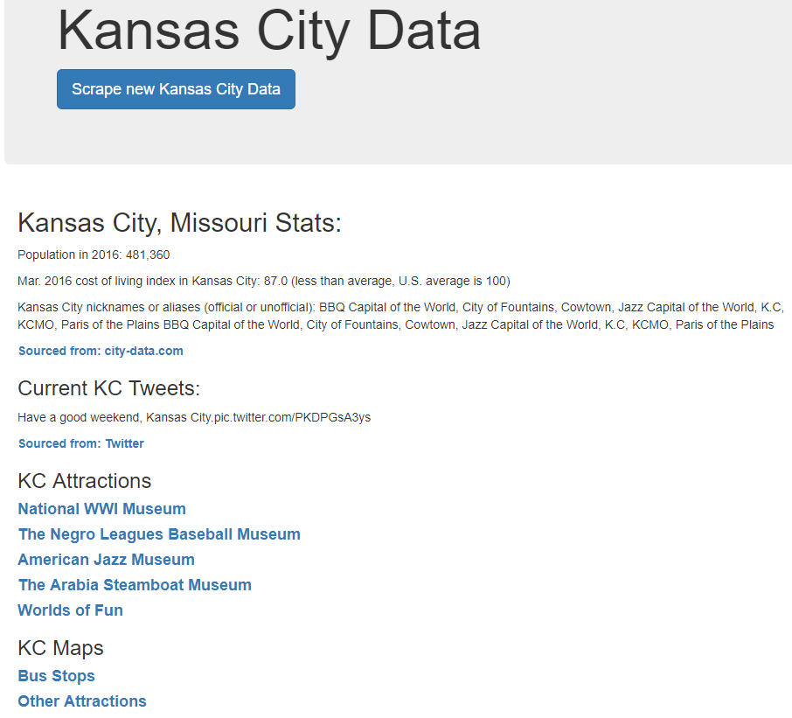
Final HTML page with scraped data and links to Attractions and Maps
Title
text
text
text

Slide 6
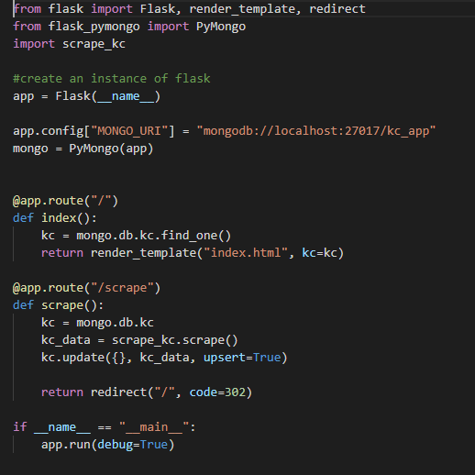
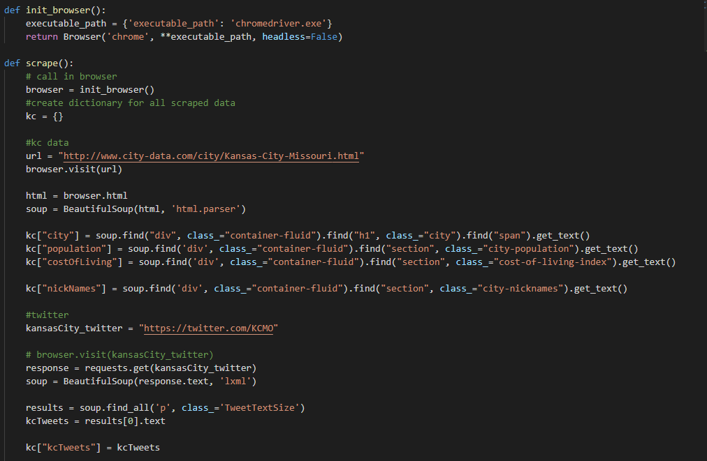
Flask App and Web Scrape App:

Slide 7
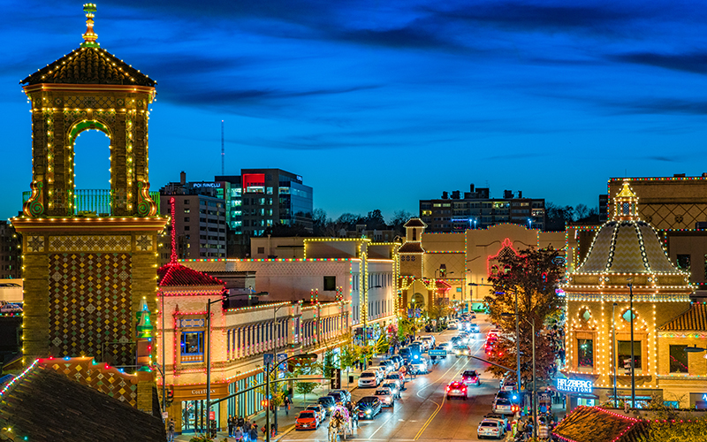
Title
More text
Text
text
2
1
Performance

Slide 8
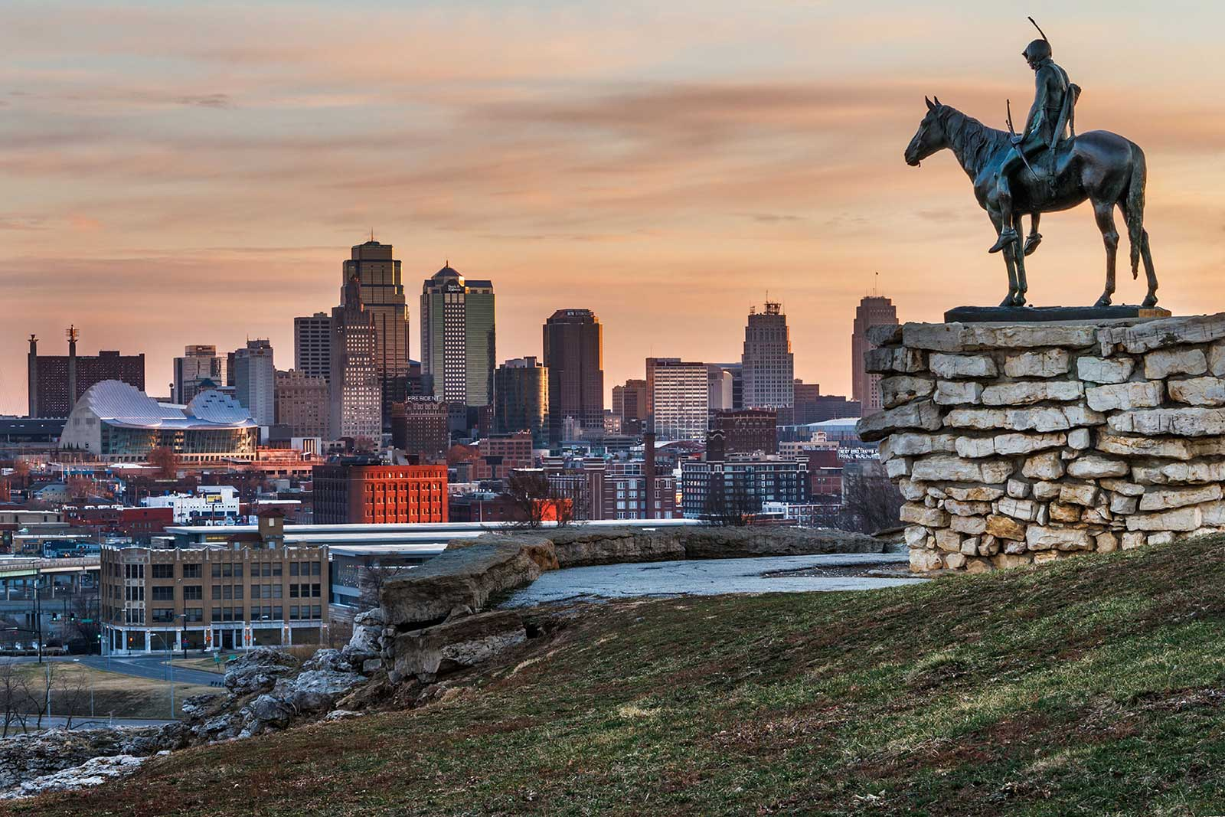
Title
Sub title
text
text2

Slide 9
Title
text

Slide 10
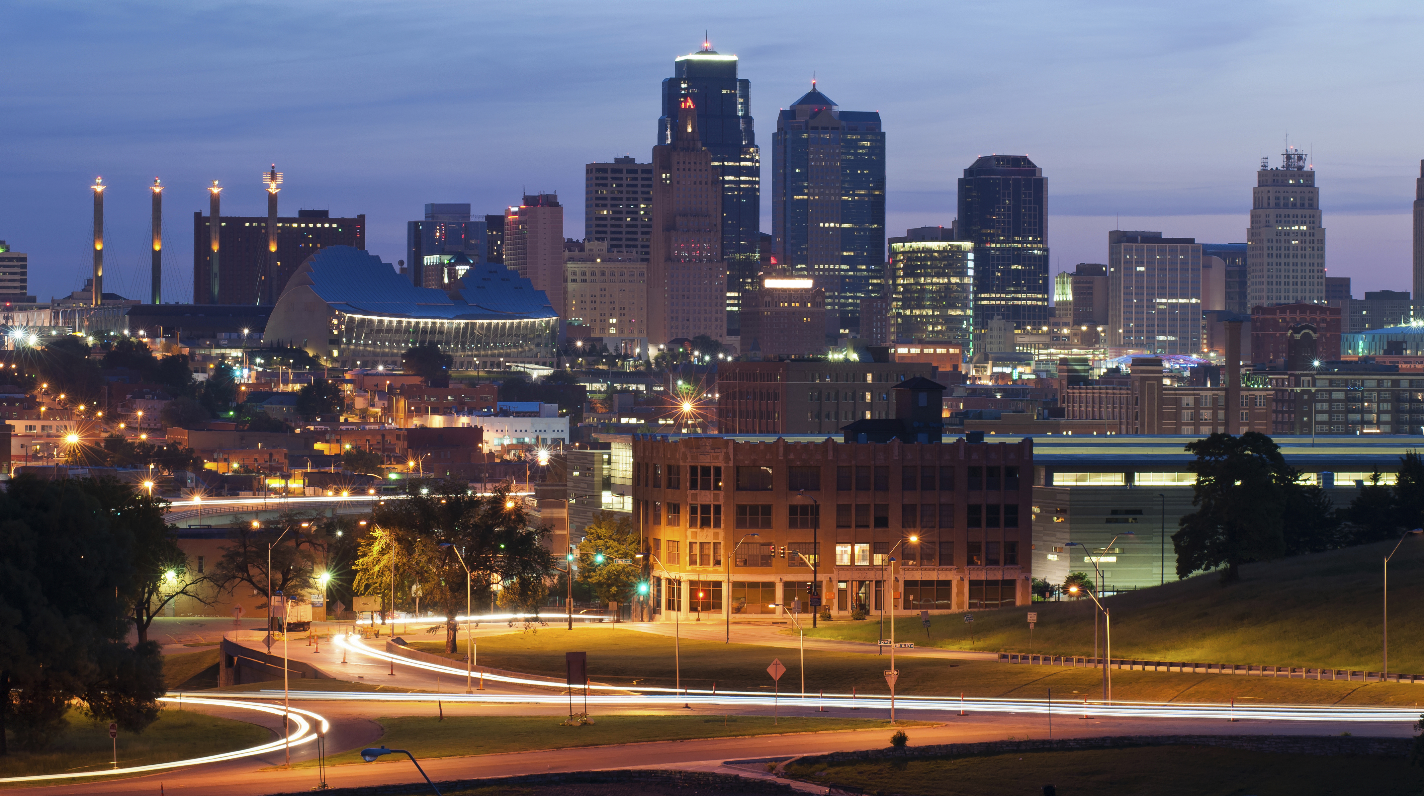
Any Questions?

